Slide 1
Arusha Herath’s Encryption Decryption Program

Slide 2
Function of the program
Functionality of this program is to take input such as a string or file containing series of characters and to encrypt it either using a default key or using user’s key. Also, get an encrypted string or a file then decrypt it using default or user’s key.

Slide 3
Why do it?
The main reason why you should do this is to hide your privacy from other people. And to keep your privacy to yourself and make it impossible for people access it without your consent
Security

Slide 4
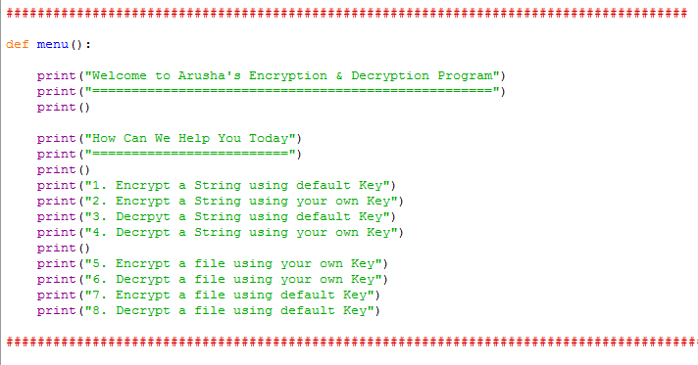
Defined functions in the code
1st function: def menu()
As you can see the functionality of the first function is to show the user the menu with list of options.
it doesn’t have a any parameters.
Also, no return value

Slide 5
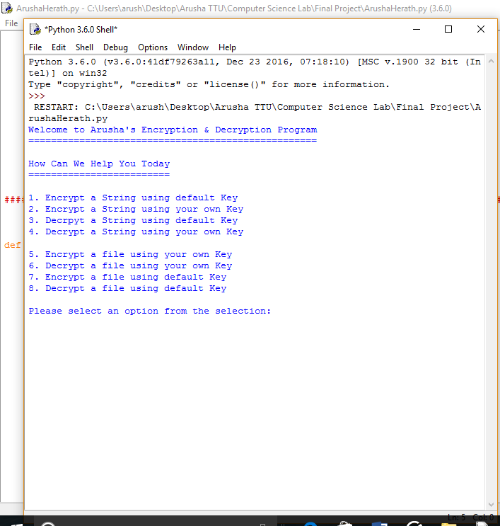
And when we run it, we see:

Slide 6
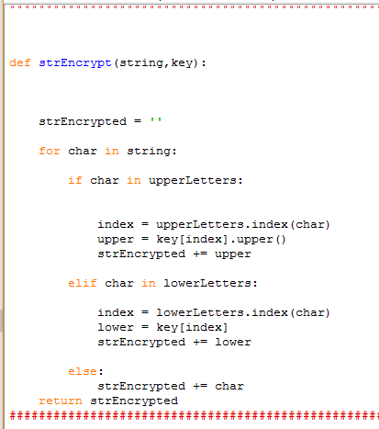
2nd Function: def strEncrypt(string,key):
as you can see that, it has two parameters,one is called string and the other one is the key.
the functionality of this function is, to take a
string and the key. then using a for loop iterate through each character and encrypt it based on the key. and at the end return the encrypted string

Slide 7
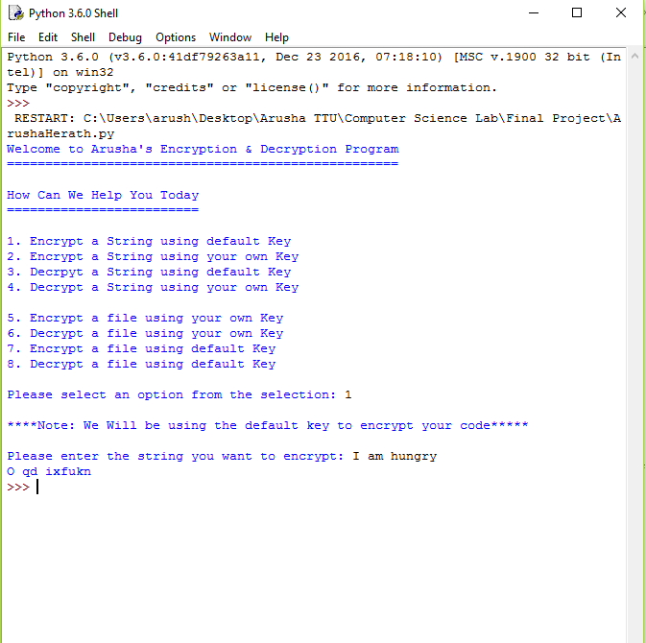
so if we run it, we can see:
you can see i select 1 which is, encrypt using a default key and when I entered a string, it showed the encryped string

Slide 8
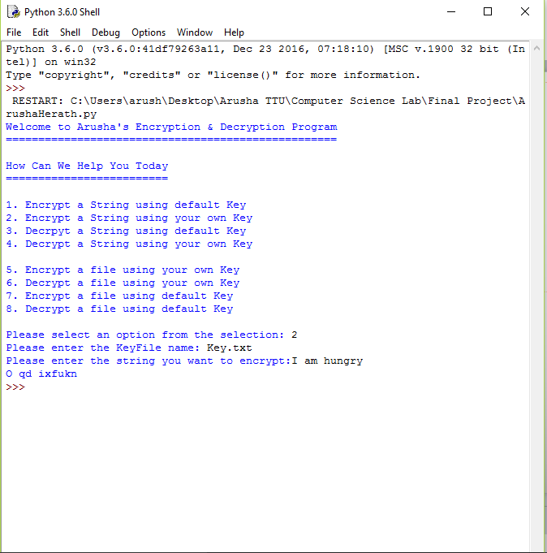
if I ecnrypt using the user's key:
as you can see, I select 2, then it asked for the file that contains the key. Then you can type the string, and it will show the encrtped string.(same as the default key)

Slide 9
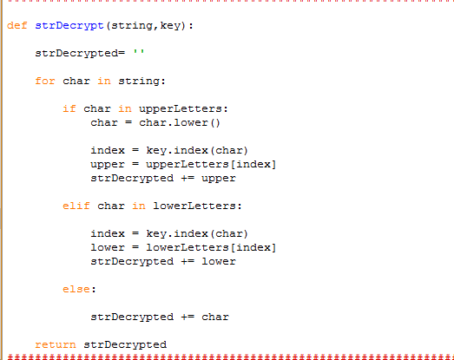
3rd Function : strDecrypt(string,key)
This function takes the encrypted string and using either default or user's key, it will decrypt it. then return the decrypted string.
as you can i used a for loop to iterate through each character and using the alphabet and the key, decrypt it back to it's orginal text.

Slide 10
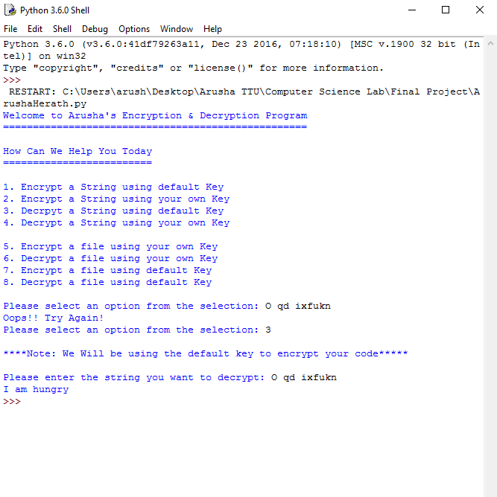
if I run it, we can see:
as you can see when I entered a something other than an option it gave me an error and asked for it again, after selecting option 3 , it asked for the encrypted string and i entered what i got from the last one, it shows the original text(plane text). this is using the default key.

Slide 11
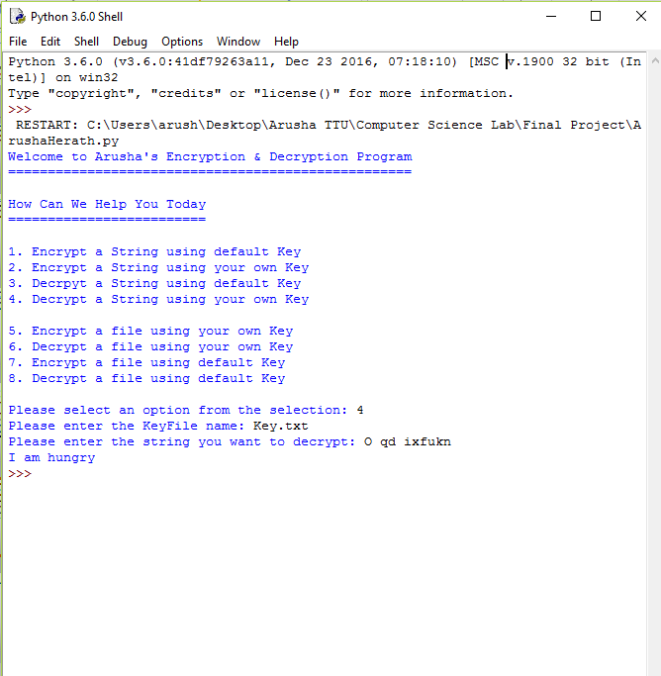
now using user's key:(same as default key)
selected option 4 which is decrypt using user's key, it asked for the file contaning the key and when i entered the same encrypted string, it shows the plane text that i entered earlier.

Slide 12
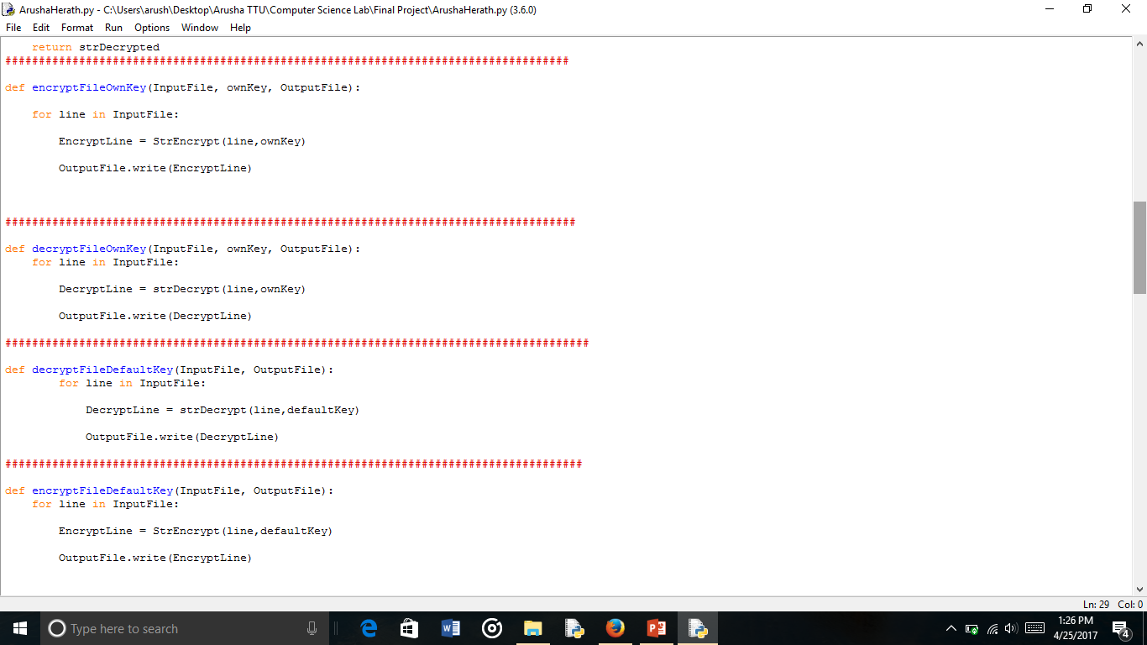
4th Function: encryptFileOwnKey(inputfile, ownkey, outputfile)
functionality of this function is to take a input file and using user's key encrypt it and save it into another file(output file).
as you can see i used a for loop, inside that for loop, i called the strencrypt function for every line(string) and wrtie it to the output file line by line.
there are no return value.

Slide 13
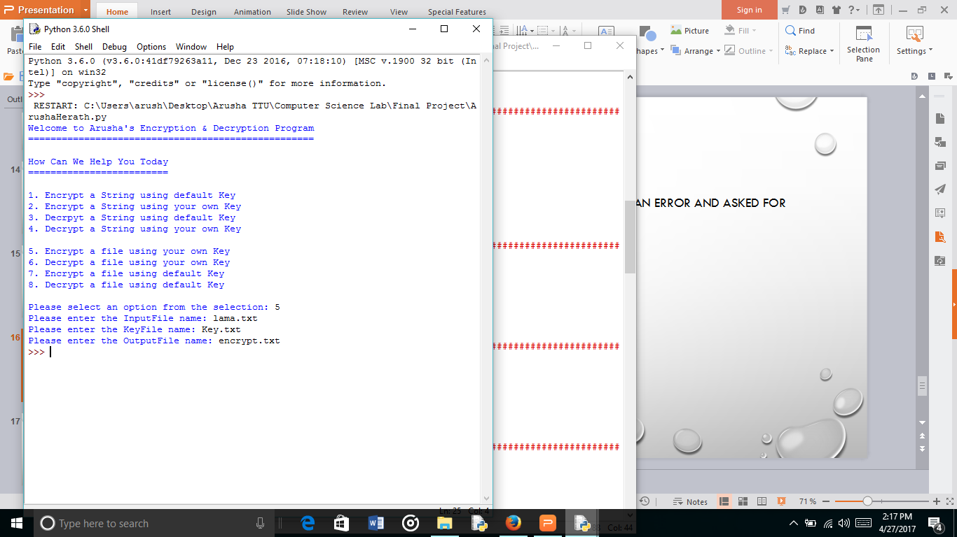
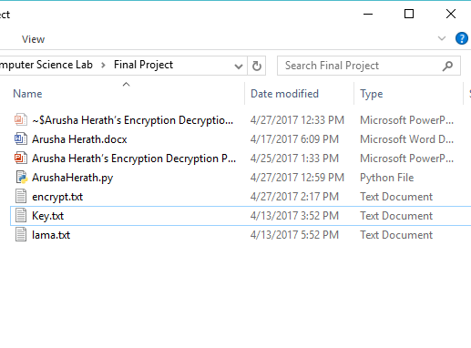
if i run it ,we can see:
it's saved the output file in the same directory as the python code.

Slide 14
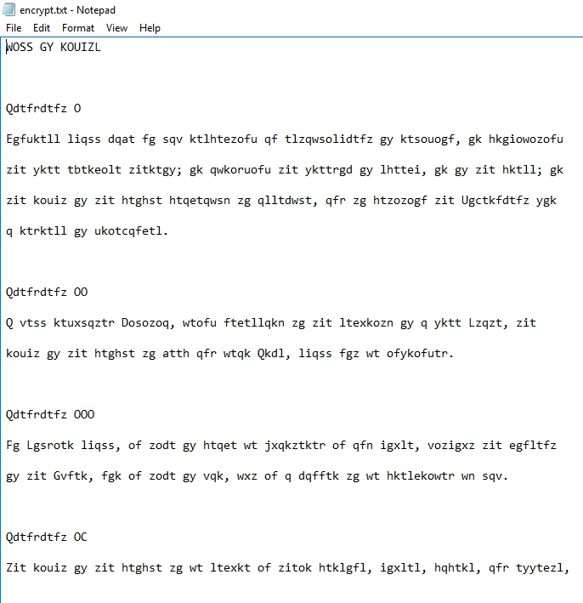
if i open encrypt.txt you can see:
it's encrypted

Slide 15
5th function: decryptfileownKey( inputfile, key , outputfile)
functionality of this function is to take a encrypted file and a key. using a for loop go through each line and each time call the strdecrypt function (line, ownkey) then write it to the output file.
there are no return value

Slide 16
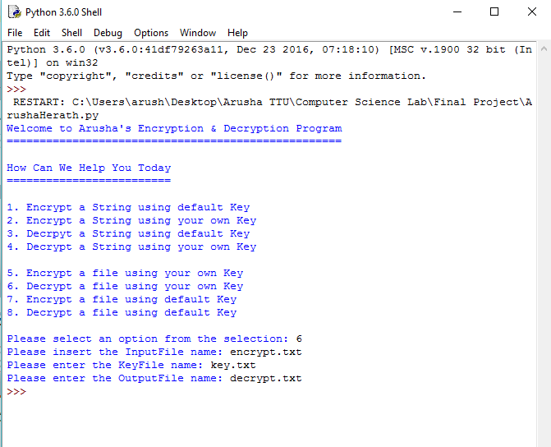
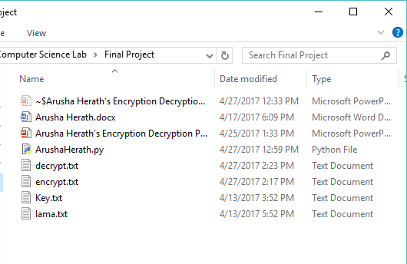
if we run, we can see:
it's in the same directory as the python code.

Slide 17
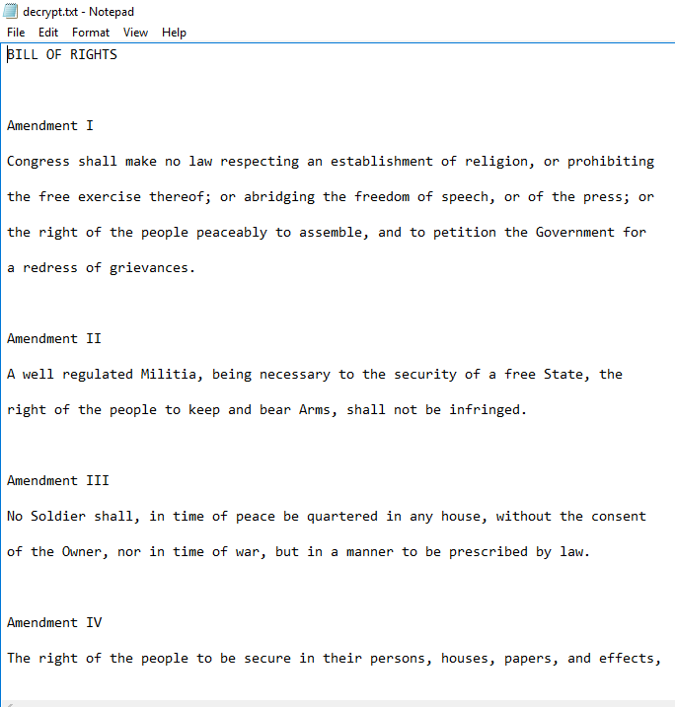
if i opened it you can see:
it decrypted line by line according to the
function.

Slide 18
6th function: encryptFileDefaultKey(inputfile, outputfile)
functionality of this function is to take a input file and encrypt it using the default key. using a for loop iterate through each line at a time and each time call the strencrypt function with line and defaultkey as the arguments. then write it to the output file.
there are no return value

Slide 19
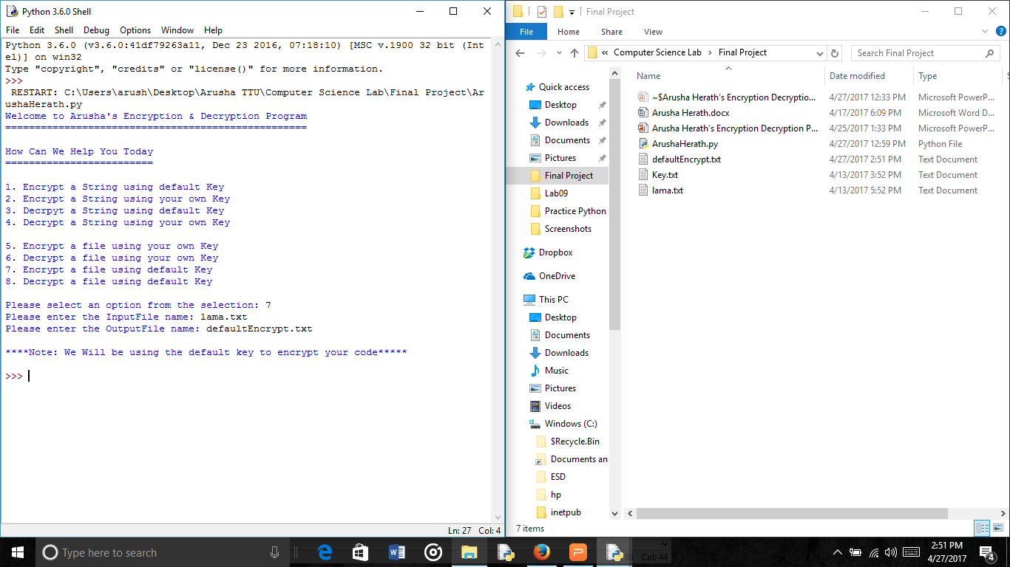
if i run it, we can see:

Slide 20
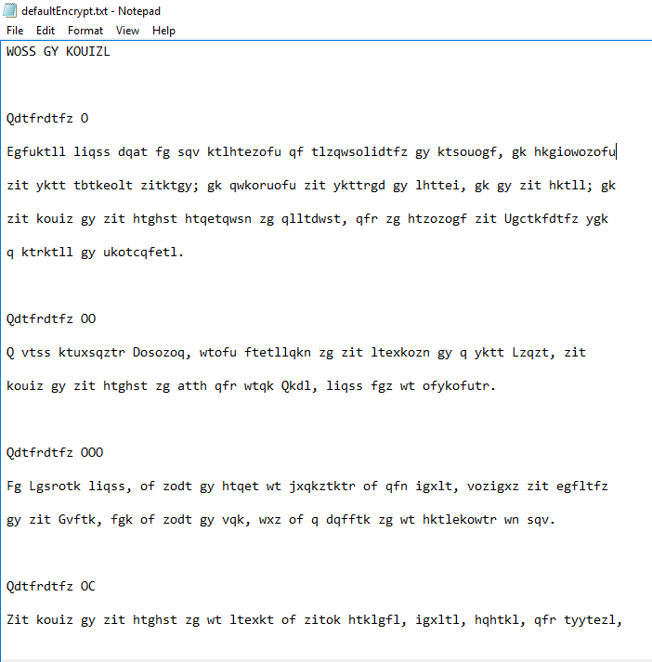
if i open defaultencrypt.txt, we can see:
it encrypted

Slide 21
7th function: decryptfiledefaultkey( inputfile, outputfile)
functionality of this function is to take an input file then using a for loop iterate through each line(string) and each time call the strdecrypt(line, defaultkey) as arugments. then write it to the output file.
there are no return value

Slide 22
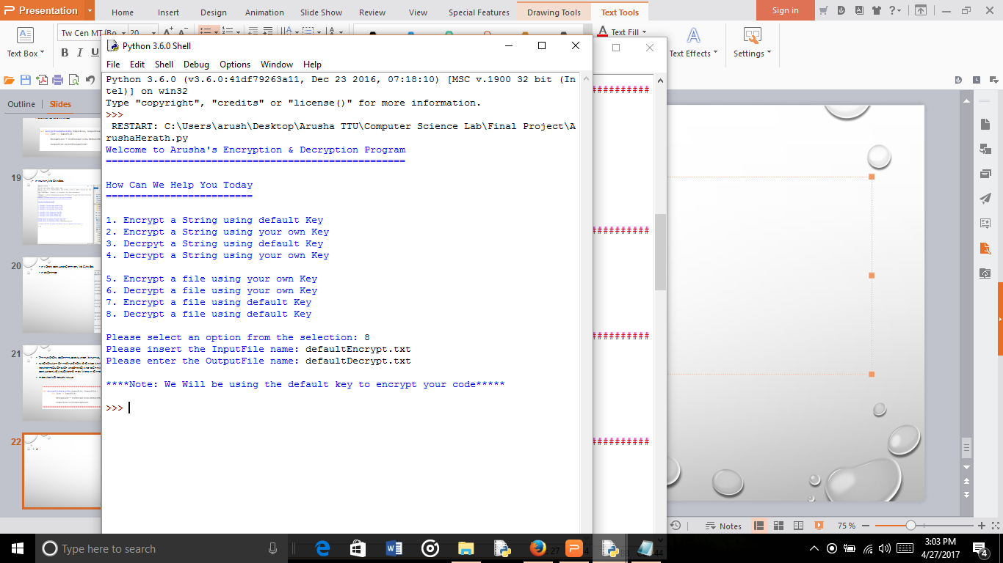
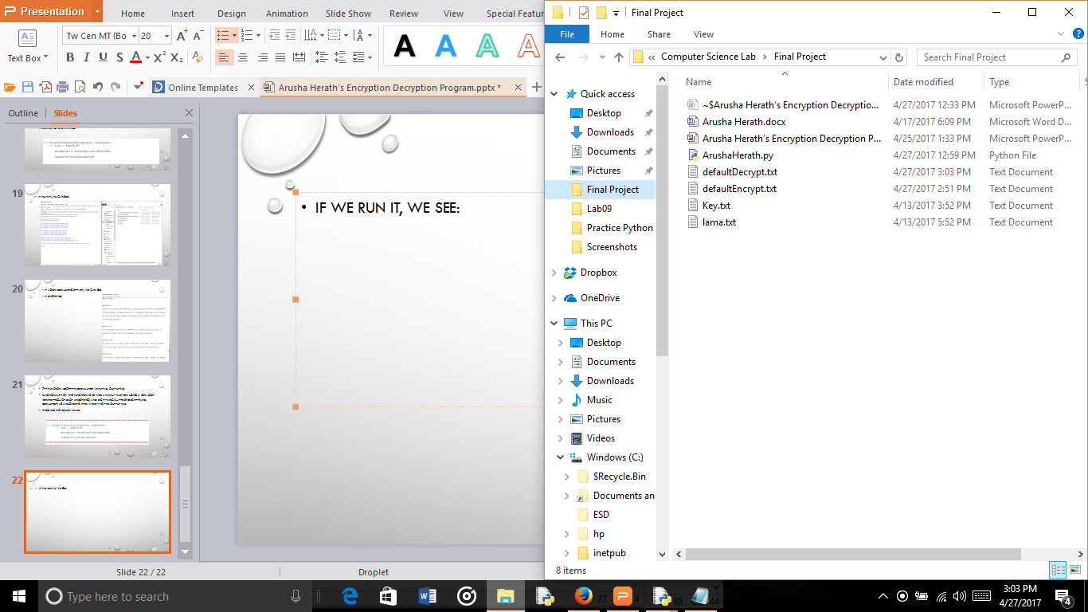
if we run it, we see:
it's in the same directory as the python code

Slide 23
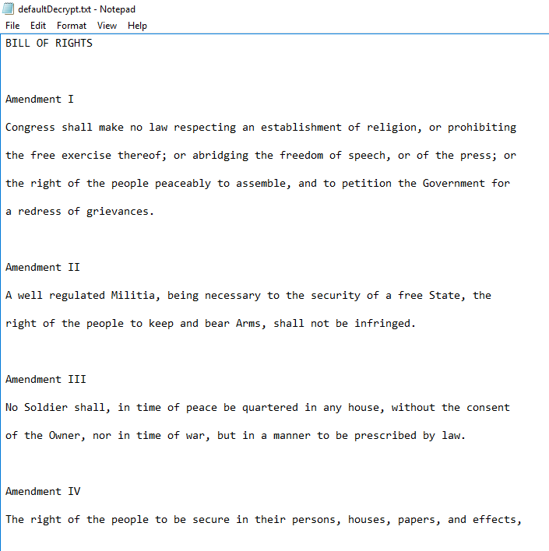
now if open defaultdecrypt.txt, you can see:
it's in plane text, meaning it decrypted
successfully.

Slide 24
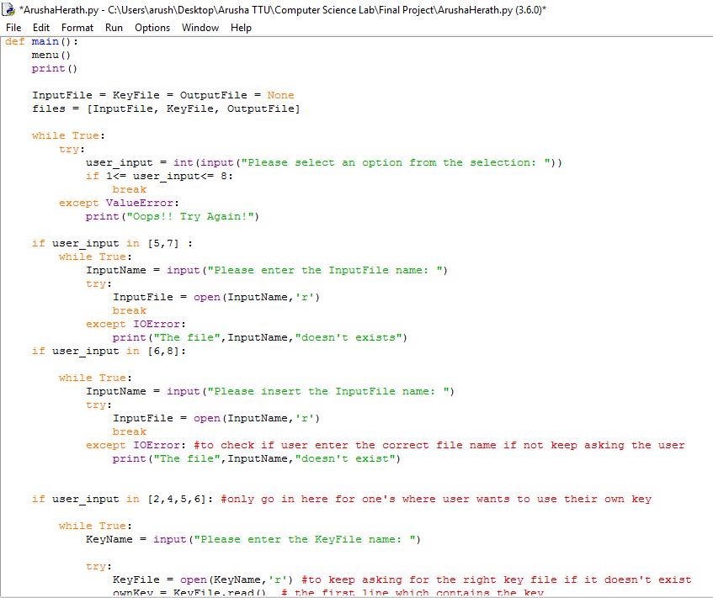
lastly the main function where i execute all the functions based on user's input
first show the menu
then ask for the input in a while loop with under try and exception, and as you can see, user's input has to be a number between 1 and 8. then if user enter 5 or 7 , goes to into the next if statement, then ask for a input file name. then using try and exception, check if the file exists or not if the user's input is either 6 or 8 goes to next if statement, and in there ask for an input file, then inside try and exception, try opening the file.

Slide 25
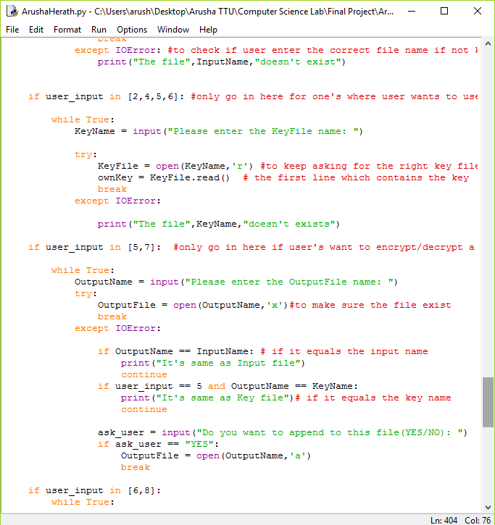
if user enter 2, 4 , 5 or 6, it goes into this statement, then it ask the user to enter the key file name, then using the try/ exception, it tries to open the file and the read the first line of it, if it doesn't exists, then it ask for the key file again.
if user enter 5 or 7 , it goes into the if statement. it will ask for an output file name, then using try/exception, it will try to see if it exists, if it does, then see if the output name equals the input name or the key name. if does then ask for another name, if there is a file already exists then, it will ask the user's permission to append it.

Slide 26
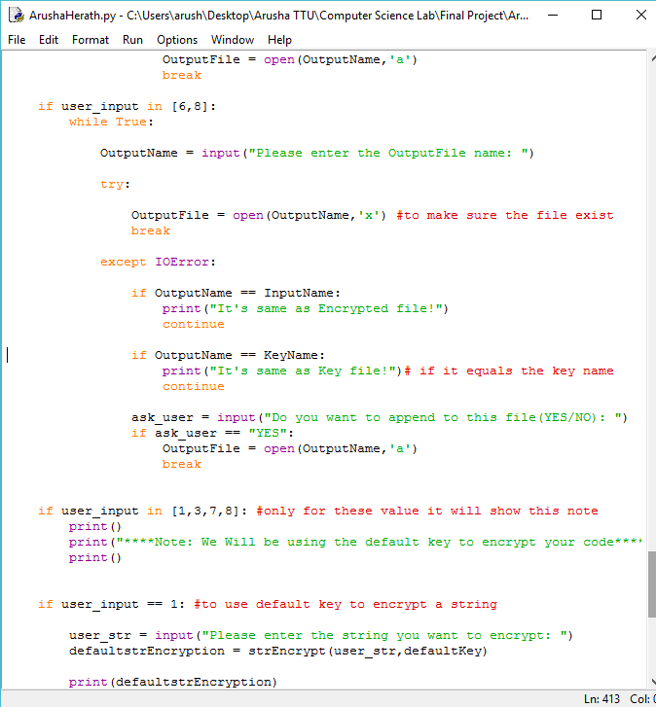
if user enter 6 or 8 , it goes into the if statement. it will ask for an output file name, then using try/exception, it will try to see if it exists, if it does, then see if the output name equals the input name or the key name. if does then ask for another name, if there is a file already exists then, it will ask the user's permission to append it.
if user enter 1, 3, 7 or 8 it will show the user a message saying that it will be using default key to either encrypt/decrypt the code.

Slide 27
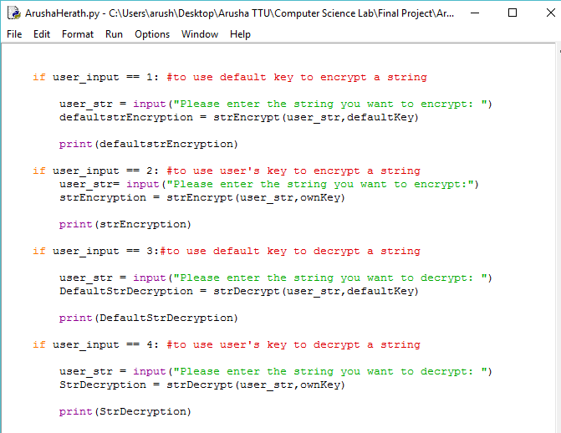
If user entered 1, then it goes into the first if statement, then aks user to enter a string, then call the strEncrpyt function with user_str and default key as the arguments and let it equal to defaultencryption.Then it will print it.
If user entered 2, then it goes into the second if statement, where it asks for user to enter a string, then call the strEncrypt function with user_str and ownKey as the arguments and let it equal to strEncryption.Then it will print it.
If user entered 3, then it goes to the third if the statement, where it ask for user to enter an encrypted string, then call the strDecrypt function with user_str and defaultkey as the arguments and let it equal to DefaultStrDecryption. Then it will print it.
If user entered 4, then it goes to the fourth if the statement, where it ask for user to enter an encrypted string, then call the strDecrypt function with user_str and ownKey as the arguments and let it equal to StrDecryption. Then it will print it.

Slide 28
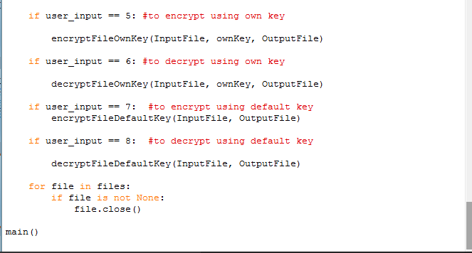
If user entered 5, then it will goes in to fifth if statement, where it will call the encryptfileownkey with input file, ownkey and output file as the arguements.
If user entered 6, then it will goes into the sixth if statement, where it will call the decryptfileownkey with input file, ownkey and output file as the arguments.
If user entered 7, then it will goes into the next if statemnt, where it will call the encryptfiledefaultkey with input file and output file as the arguments.
if user enterd 8 then it will goes in to the last if statement where it will call the decryprtedfiledefaultkey with input file and output file as the arguments.
Then, after it will goes into the for loop where it will iterate through the files list, and it will close the files then we opened.
At the end, close the main function.

Slide 29
The End

